Slide 1
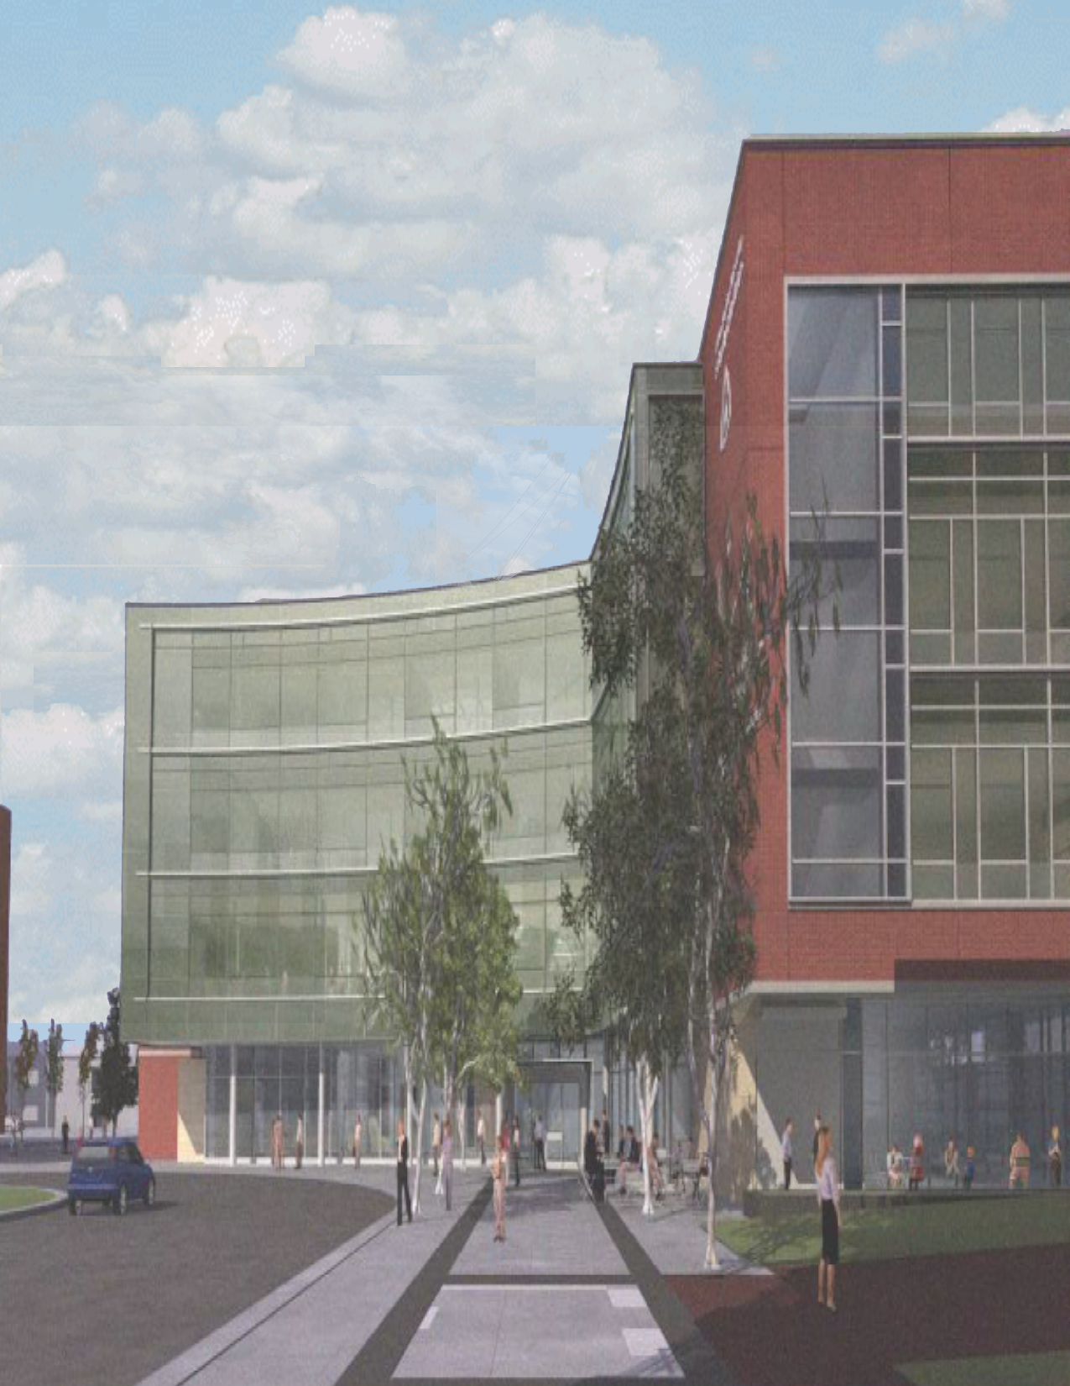
Medical Education Building
Johns Hopkins University School of Medicine
Electrical Systems Existing Conditions and
Building Load Summary Report
Mr. Ted Dannerth
Landon Roberts
Lighting/Electrical Option
11/01/07
The Anne and Michael Armstrong Medical Education Building
Johns Hopkins University School of Medicine
Technical Assignment II

Slide 2
Table of Contents
Landon Roberts
Lighting/Electrical Option
11/01/07
3 Executive Summary
4 Power Distribution Systems
4 Distribution System Description
Service Entrance
Voltage Systems
5 Transformers
Emergency Power System
Over-current Devices
6 Locations of Switchgear
Power Factor Correction
Design Issues
Lighting Loads
7 Mechanical and Other Loads
Service Entrance Size
Utility Company Information
7 Communication Systems
Communication System Description
Audiovisual System
Fire Protection System
9 Appendices
10 Appendix A: Single Line Diagram
11 Appendix B: Feeder Schedule
12 Appendix C: Transformers
13 Appendix D: Emergency Single Line Diagram
14 Appendix E: Switchgear Locations
15 Appendix F: Luminaire Schedule
16 Appendix G: Mechanical Loads
17 Appendix H: Service Entrance Sizing
18 Appendix J: Baltimore Gas & Electric Company Utility Rates
Medical Education Building
Johns Hopkins University School of Medicine
Electrical Systems Existing Conditions and Building Load Summary Report

Slide 3
Executive Summary
Landon Roberts
Lighting/Electrical Option
11/01/07
The electrical distribution system in the Anne and Michael Armstrong Medical Education Building comes from one 1500KVA transformer located behind the pump house on the northeast side of the building. The majority of the lighting, receptacle and mechanical equipment runs on a 480Y/277V system with the exception of some of the receptacle loads and emergency receptacle loads.
The majority of the lighting in the building is controlled by occupancy sensors and lighting controls to minimize electricity usage throughout the building. The small group rooms utilize a more extensive occupancy sensor, photocell, manual switch combination to control the lighting within the spaces.
The learning spaces including the labs, meeting rooms and auditoriums consist of an elaborate communications system to supplement the student learning. Interactive whiteboards, flat screen television panels and various floor box outlets provide for more flexible classroom layouts and enhance student learning..
Medical Education Building
Johns Hopkins University School of Medicine
Electrical Systems Existing Conditions and Building Load Summary Report

Slide 4
Power Distribution Systems
Landon Roberts
Lighting/Electrical Option
11/01/07
Description of Power Distribution System
The Armstrong Medical Education Building consists of a radial system to power the building, tapping power from the campus distribution system. The service comes from two 13.2KV transformers tapping power from two 15KV feeders located behind the adjacent pump house northeast of the building. The power enters the building in the Normal Electric room E116 to power the main switchboard. The main switchboard has 6 switches that distribute 480Y/277V power to lighting, electrical and mechanical loads and 1 switch that distributes 280Y/120V power to a low voltage distribution panel mainly for receptacle loads. Two of the 480Y/277V lines connect to the emergency power. A 300KW 480Y/277V emergency generator is located on the northwest end of the site. This generator supplies power to the roof and also for the fire pump, lighting and receptacle loads.
Refer to Appendix A: Single Line Diagram and Appendix B: Feeder Schedule.
Service Entrance
Two sets of 15KV, 4/0 feeders tap power for the Medical Education Building from existing feeders supplying power to the adjacent Reed Hall and Hampton House buildings in the existing Manhole No. 18 which derives power from the Turner Switching Station. The power comes in from the pump house to the building in the electrical and emergency electrical rooms, E116 and E119, respectively.
Voltage Systems
The secondary voltage system for the Medical Education Building is 480Y/277 volts, 3 phase, 4 wire. This system serves the majority of the lighting and mechanical loads. There is also a 480 volt, 208Y/120 volt, 3 phase, 4 wire transformer serving the normal low voltage distribution panel as well as several emergency receptacle distribution panels. The normal power distribution panel feeds most of the receptacle loads in the building from an 800A busway. It also provides power to LCD screens, vending machines and projector equipment throughout the building.
Medical Education Building
Johns Hopkins University School of Medicine
Electrical Systems Existing Conditions and Building Load Summary Report

Slide 5
Power Distribution Systems
Landon Roberts
Lighting/Electrical Option
11/01/07
Transformers
All the transformers in the building are step down transformers.
Refer to Appendix C: Transformers.
Emergency Power System
The campus emergency power comes from a 300kW diesel generator located on the northwest side of the building. Power is supplied to the Emergency Distribution Panel located on the first floor Emergency ATS Room at 480Y/277V. The power is distributed through a 14,000 A.I.C. substation feeding a 600A bus. A 400A automatic transfer switch will transfer from normal power to emergency power for rooftop emergency power. A 260A automatic transfer switch will transfer from normal power to emergency power for all lighting, receptacle and other loads within the building.
Refer to Appendix D: Emergency Single Line Diagram and Appendix B: Feeder Schedule.
Over-current Devices
The main switchboard of the Medical Education Building is protected by a 3-pole 1600 A circuit breaker. The secondary equipment is protected by individual circuit breakers within the main distribution panel sized appropriately for each load. Within each distribution panel a sized circuit breaker protects each individual panel board to provide redundant protection within the system.
Medical Education Building
Johns Hopkins University School of Medicine
Electrical Systems Existing Conditions and Building Load Summary Report

Slide 6
Power Distribution Systems
Landon Roberts
Lighting/Electrical Option
11/01/07
Location of Switchgear
The majority of the switchgear is found in the designated electrical rooms found on each respective floor within the Medical Education Building. Included with the switchgear is general information and where the information can be located in the set of drawings.
Refer to Appendix E: Switchgear Locations.
Power Factor Correction
I was unable to find any information regarding power factor correction in the Medical Education Building.
Design Issues
Various design requirements must be considered as the electrical systems are designed and implemented in the Medical Education Building such as voltage drop, reliability issues and system protection. Voltage drop is important when sizing the electrical equipment throughout the building. Redundant protection is provided within the main switchgear and panelboards to protect the equipment from overloading and outages.
Lighting Loads
The large auditorium space on the first floor consists of two Lutron Grafik Eye Series 4100 dimming systems for the east and west side of the space in order to accommodate the various functions in the building. It is also gives the space more flexibility to be split in half.
The small group rooms along the glass curtain wall on the third and fourth floors each consist of a Lutron Grafik Eye, Photocell and Manual wallstation switch combination to minimize electric lighting and maximize daylighting usage in each space.
Medical Education Building
Johns Hopkins University School of Medicine
Electrical Systems Existing Conditions and Building Load Summary Report

Slide 7
Power Distribution Systems
Landon Roberts
Lighting/Electrical Option
11/01/07
The majority of the circulation space, classroom/office space, lab space and meeting space consists of a system of linear and compact fluorescent fixtures tied to occupancy sensor controls. The auditorium, atrium and outdoor canopy also utilize HID fixtures.
Refer to Appendix F: Luminaire Schedule.
Mechanical and Other Loads
Included in the load schedule are all the mechanical, plumbing, and architectural equipment and the electrical operating conditions for each piece of equipment.
Refer to Appendix G: Mechanical and Other Loads.
Service Entrance Size
The service entrance size is calculated for various phases of the building design process. As the process progressed the calculations become more specific.
Refer to Appendix H: Service Entrance Sizing.
Utility Company Information
The power for the Medical Education Building is connected to a campus system provided by Baltimore Gas & Electric, Room 203 Lord Baltimore Building P.O. Box 1475, Baltimore MD, 21298. Their website is http://www.bge.com/portal/site/bge/.
Refer to Appendix J: Baltimore Gas & Electric Company Utility Rates.
Medical Education Building
Johns Hopkins University School of Medicine
Electrical Systems Existing Conditions and Building Load Summary Report

Slide 8
Power Distribution Systems
Landon Roberts
Lighting/Electrical Option
11/01/07
Communications Systems
An extensive audio-visual communications system infrastructure can be found throughout the Medical Education Building. In the main first floor auditorium there are audiovisual floor boxes with receptacles, voice/data connections and an audiovisual connection on each desk. There is also an 18’ x 10’ projection screen and 7’ x 4’ electronic whiteboard on each side of the front wall of the auditorium. The projection screens also have permanent speakers located behind them. The majority of the meeting rooms and gathering rooms, such as the four college spaces on the second floor, have various flat, touch screen televisions, interactive whiteboards and projector screens.
The Medical Education Building has a fully sprinklered fire protection system throughout the building. The majority of the structure including the ceiling, floors, structural elements, elevator shafts and stairwells are fire rated at 2 hours. The atrium is provided with automatic sprinkler protection, smoke control, a smoke barrier and standby power.
Medical Education Building
Johns Hopkins University School of Medicine
Electrical Systems Existing Conditions and Building Load Summary Report

Slide 9
Appendices
Landon Roberts
Lighting/Electrical Option
11/01/07
Medical Education Building
Johns Hopkins University School of Medicine
Electrical Systems Existing Conditions and Building Load Summary Report

